Slide 1
Impact of performance on security: JWT Token
Neelakshi Soni

Slide 2
CONTENT
Abstract
Introduction
Related Method
Methodology
Design and Implementation
Experiment
Result
Evaluation
Conclusion

Slide 3
Abstract
Microservices are gaining a lot of popularity among industry users
Microservices are collections of independent, small services to make a big application.
Scalability, loose coupling, and automation are fundamentals, which makes it more vulnerable
To make it secure, we have developed our services using a JWT token.
Developed a fictitious e-commerce service and reverseSTS service for generation of tokens.
Both are tested by sending sequential requests.
Our findings show that the performance overhead of using JWT tokens is 8%, which is significantly higher.
It shows the trade-off between security and performance.

Slide 4
Introduction
Advantages of using microservices : -
High cohesion and loose coupling.
Independent deployable
Scalability
Encapsulation
Fault Isolation and resilience

Slide 5
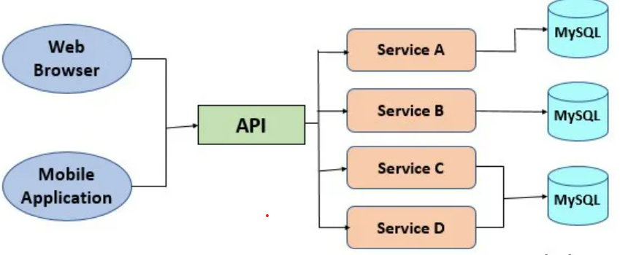
Microservice Architecture

Slide 6
Challenges associated with microservices:-
Authorization across multiple services can be complex and risky.
Exposing APIs to third parties in microservices.
Microservices are highly scalable, making them susceptible to resource exhaustion attacks.
Microservices use REST APIs. These are at risk of eavesdropping (sniffing), identity spoofing, session hijacking, Denial of Service (DoS), and Man-in-the-Middle (MITM) etc.
Microservices are deployed on the cloud. Therefore, it leaves little room to do anything related to technical aspects to prevent attacks or disruption.

Slide 7
JWT (JSON Web Token)
It is used for authentication for services. It is one of the security mechanism practices.
When a user logs in, they receive a JWT token.
This token contains information about the user and is signed by the server. When the user makes subsequent requests, they include this token, allowing the server to verify their identity without the need to send credentials (e.g., username and password) with every request.
JWT tokens can have an expiration time. This adds a layer of security by ensuring that even if a token is intercepted, it will only be valid for a limited time.
It is a stateless service; it does not need to store session information. It can be encrypted, but mainly it is encoded and signed.

Slide 8
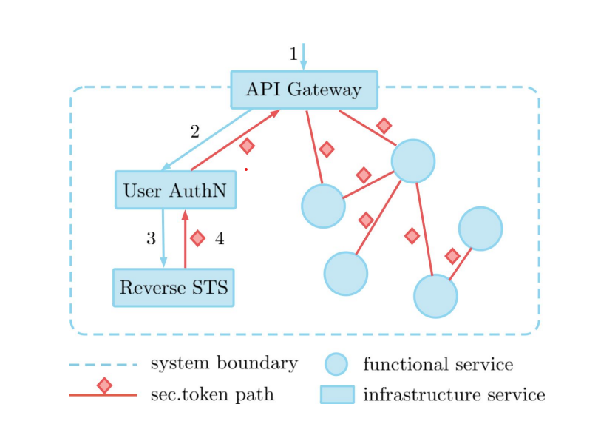
JWT token

Slide 9
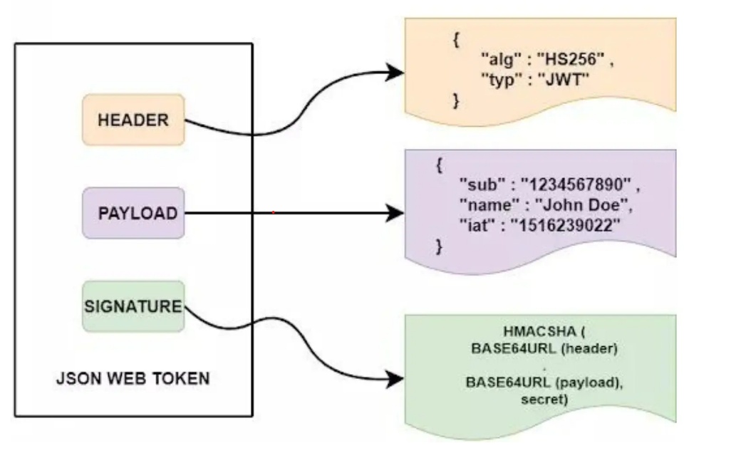

Slide 10
JWT Token
Used OpenSSL, for generating these two certificates
servicecert.pem – It verifies the JWT token with the help of a public key certificate. This certificate contains the public key. It is used to validate the authenticity of JWT tokens between different parties.
servicekey.pem: - It contains the private key. It is used to sign the JWT token that has been created and used to prove the authenticity of JWT. It is kept private and secure.
RSA Signature with SHA-256 is used as a signing algorithm.

Slide 11
REST APIs: -
In our paper, microservices are communicating with each other through RESTful APIs. REST APIs are HTTP. These are language-agnostic.
REST APIs do not store the user session information, these are stateless, which further helps in reducing the surface area.
It uses the HTTP methods, which makes it easier to implement any security practices.
Encryption protocols such as SSL/TLS can be used to secure data in transit.
It is easier to give specific access for any permission to a specific resource.

Slide 12
Related Work
OAuth 2.0, OpenID Connect, API Gateway, and JWT are used to mitigate the risk of attack in microservices.
The longer the response time, the better security it has.
Use of SSL solution to make it more secure.
Service mesh technology can help in reducing the attacks to the largest number.
Vertical scaling costs less on cloud platforms like Azure Cloud than horizontal scaling.
OpenID Connect is the best protocol to be used for authentication and authorization. As it uses OAuth 2.0 for authorization. The system does not need to store a username and password in the database. It reduces the overhead of maintaining storage for this separately. It also helps in preventing intrusion attacks.
Machine learning algorithm can be implemented to monitor any threats or the process of threat detection or any security vulnerabilities can be automated

Slide 13
Methodology
We have developed a fictitious e-commerce application, which consists of the following micro-services.
User Service – It manages the users. It has the functionality to add users, remove users, and log in to a user. Users can log in with the help of a username and password. The user will be issued a UserID and JWT token, which will have an expiry time.
Account Service – every user will have an account linked with userID. This service has the functionality of getting account numbers related to that particular user ID and updating the balance of a particular account no or account not associated with the userID . Users can close the account, open the account, and update the balance in the account through userID and account number.
Inventory Service – It has an inventory of 1000 products with product, product description, product price, and stock. It has the functionality of adding any new product with all its details, to get all the details through product ID and updating of stock through the productid.
Cart Service – every user has his cart. Users can add the items to the cart, remove them from the cart, and check out the cart.
API gateway: The main entry point to the system.

Slide 14
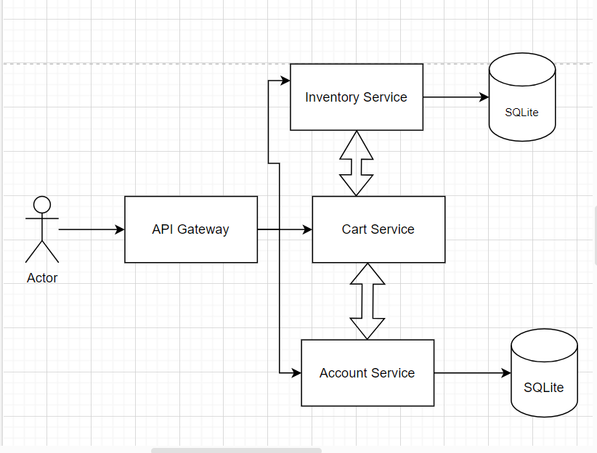
Experiment setup: e-commerce operation

Slide 15
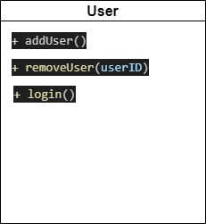
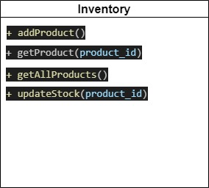

Slide 16
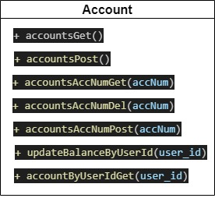
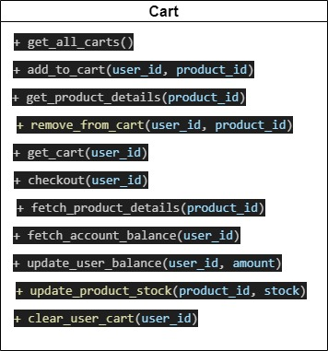

Slide 17
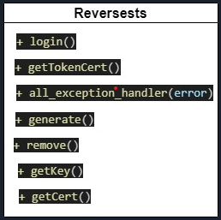

Slide 18
Experiment
We ran the experiment in two parts:
Baseline. Running the test client against the e-commerce model with security features disabled.
Tokens. Running the test client against the e commerce model with the Reverse STS service in place and JWT tokens validation.

Slide 19
Infrastructure setup:-
The system is written in the Python v3.1 programming language. All the HTTP methods get, put, delete and update are accessed using REST APIS. We have implemented all of these using Flask. We can set the number of workers per server. Account and user service maintain their individual SQLite databases, making every microservice loosely coupled. To maintain the simplicity of the experiment, each microservice has only one instance. Each service can run individually.
We conducted our experiments on a server running the Linux operating system, specifically using the HPC-login system, which is based on the Linux kernel version 5.14.0-284.18.1.el9_2.x86_64. This system utilizes x86_64 architecture.

Slide 20
Testing the client :-
The test client registers two users and opens accounts for them.
Consecutively, a balance is added to their accounts.
Then, the test client is tested against 1, 10, 100, 500, 1000, 2000 and 5000 requests.
These requests are sent sequentially.
To perform checking out operations. We add the number of requested products to the respective user’s cart and, after that, carry out a series of checkout operations.
For every request, the experiment is performed without any security features or by using a JWT token for authorization.
To measure the system performance, an average execution time of checkout requests is calculated on the client side.
Total response time and throughput are also noted for checking out the cart for all number of requests.
The checkout operation involves four microservices.
In the given setup, checkout operations always succeed. If a user’s account does not have enough balance, then it fails

Slide 21
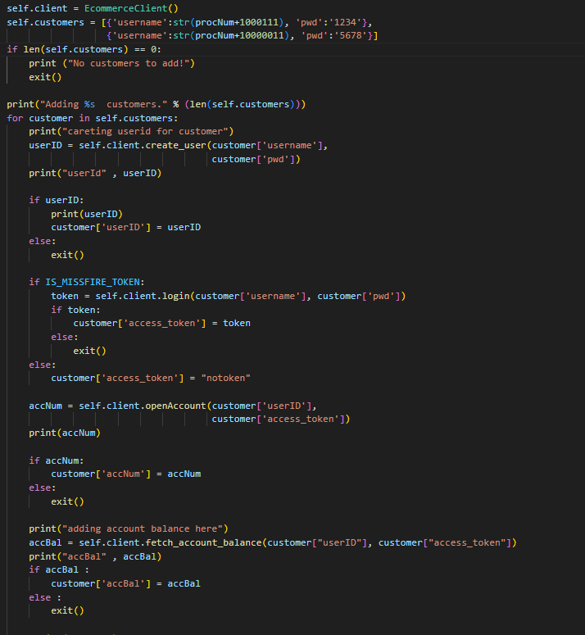
Code snippets

Slide 22
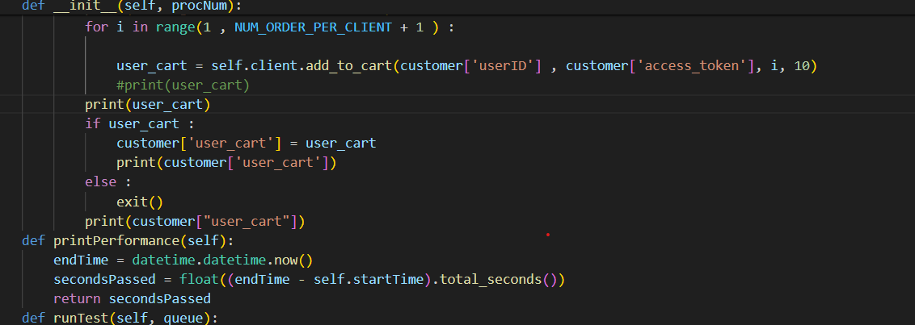

Slide 23
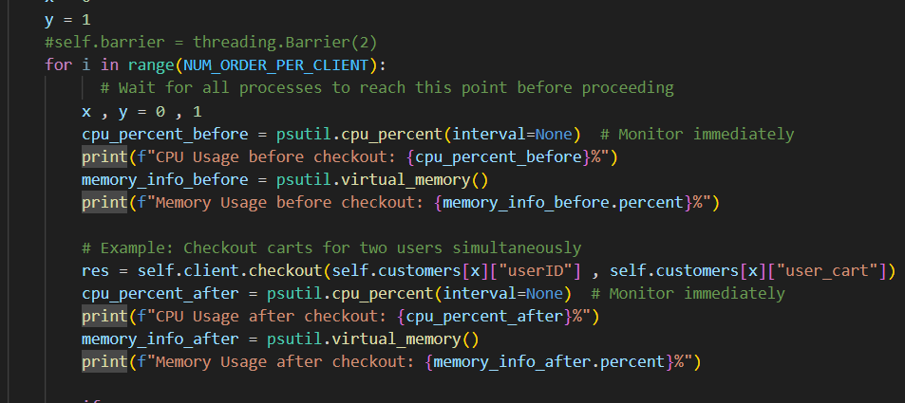
Code snippets

Slide 24
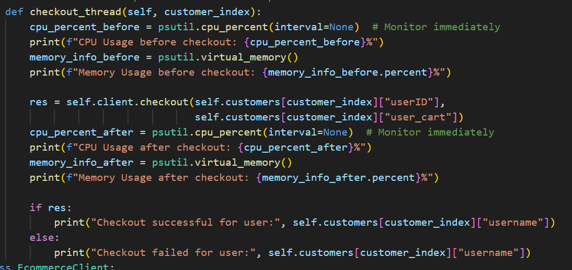
Code snippets

Slide 25
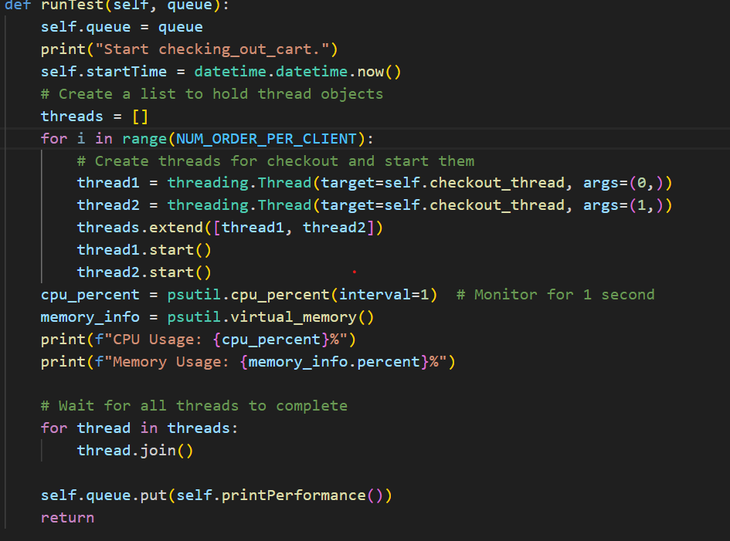
Code snippets

Slide 26
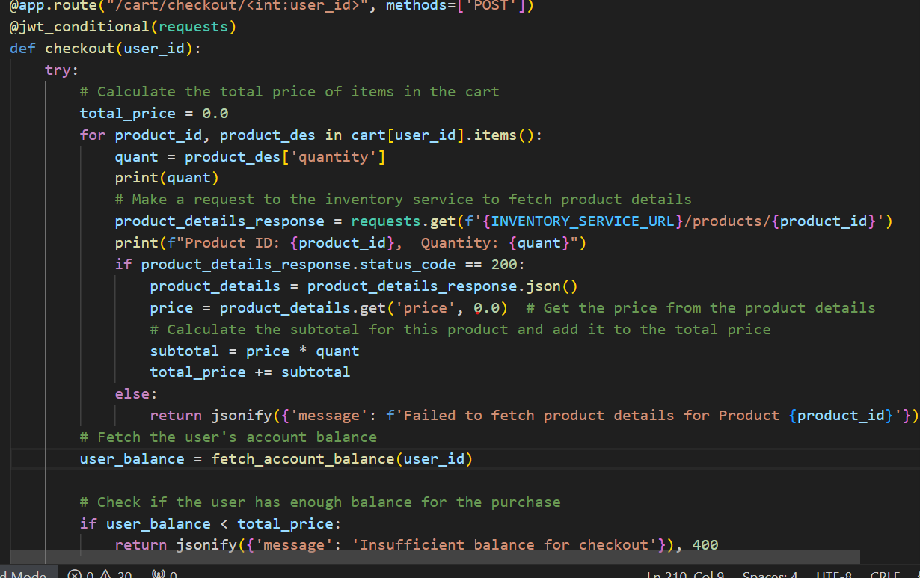
Checkout_cart function

Slide 27
Sequentially request without any security features enabled
Total no of requests | CPU usage | Memory usage | Total Response Time(seconds) | Throughput (Transactions per second)
1 | 1.4% | 16.2% | 0.010 | 100
10 | 1.9% | 16.2% | 0.03 | 333
50 | 6.5% | 16.2% | 0.124 | 403.06
100 | 6.5% | 16.2% | 0.24 | 416
500 | 6.5% | 16.2% | 1.51 | 331
1000 | 6.7% | 16.2% | 2.127 | 470
2000 | 7.1% | 16.9% | 4.66 | 429
5000 | 7.5% | 16.9% | 11.23 | 445

Slide 28
Sequential request with JWT token
Total no of requests | CPU usage | Memory usage | Total Response Time | Throughput (Transactions per second )
1 | 1.7% | 23.8% | 0.010 | 100
10 | 1.9% | 23.8% | 0.031 | 322
50 | 7.4% | 23.7% | 0.130 | 384
100 | 7.5% | 23.6% | 0.27 | 370
500 | 7.6% | 23.6% | 1.55 | 322
1000 | 7.7% | 23.6% | 2.47 | 404
2000 | 7.7% | 23.7% | 4.80 | 416
5000 | 8.2% | 27% | 12.01 | 416

Slide 29
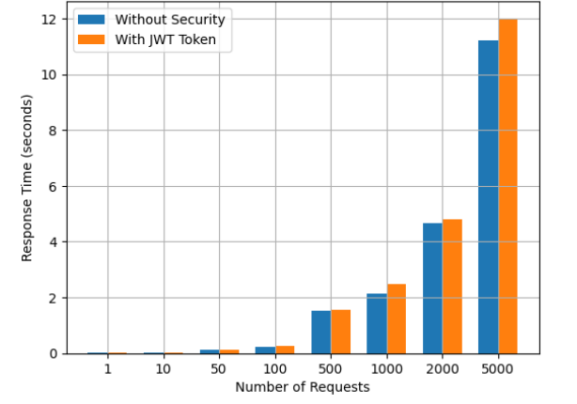
Response Time Comparison: With and Without JWT Token

Slide 30
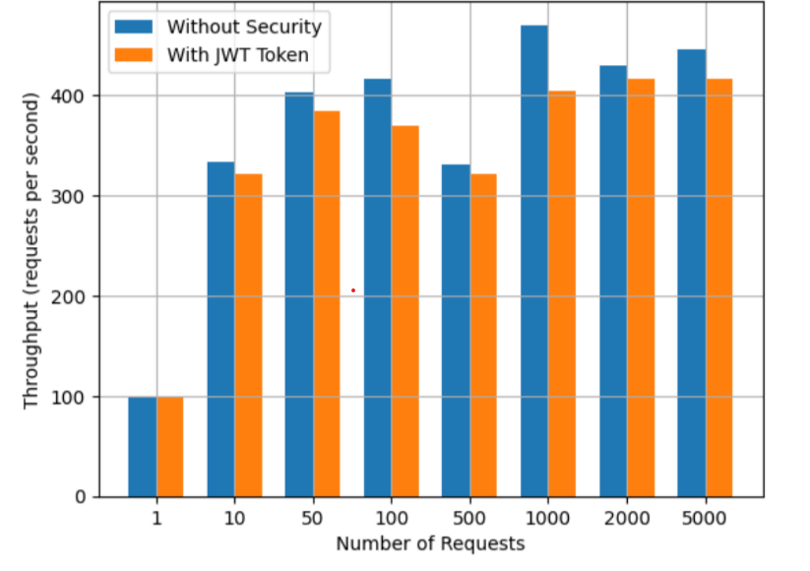
Throughput comparison: With and Without JWT Token

Slide 31
Result of an experiment
As expected, the throughput is much higher in the case of sequential requests without any security.
A closer inspection of the data shows that performance, for a single request, the overhead with the JWT token is almost null, which has increased to 13.86% for 1000 requests.
It shows that when the system handles more requests, the overhead introduced by the JWT token also increases.
CPU usage was intensive for more requests, however, the memory consumption remained fairly the same for each request.
As the payload increases, the latency increases as well. This is due to the increased processing time of all requests, which results in longer response time for individuals.

Slide 32
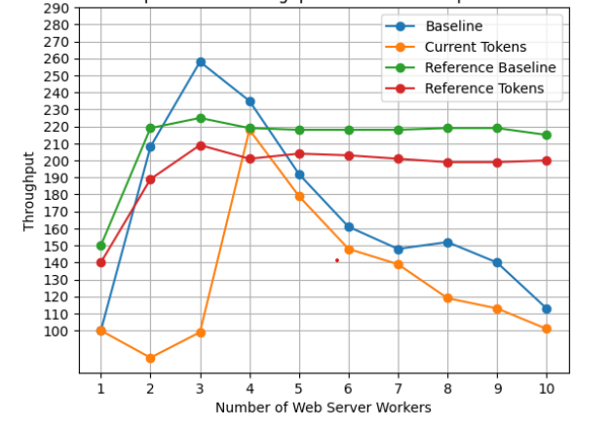
Comparison of our experiment with Yargina [3] experiment

Slide 33
Slow performance of our e-commerce model
The relatively slow performance of our bank model can be attributed to the following:
1) Synchronous HTTP communication: sequential requests and no parallelization;
2) Slow database access.
3) Python is not as efficient as certain other programming languages;
4) Suboptimal configuration of the web servers. Also, the e-commerce model is only a proof-of-concept and offers limited performance and no scalability.

Slide 34
EVALUATION: Security Considerations:
No new protocols related to cryptography were proposed.
There might be implementation flaws as well.
To get a more accurate and better result, we need to run it in a more rigorous environment.
Token authentication service can be implemented with access control, attribute control, or any customized security feature, where we can grant some permission or access to a user, or maybe put more information or longer messages in the token to make it more secure.
We have used only 1 CPU; more CPUs can be utilized for load testing using any cloud provider's service is one of the solutions.
Such potential future studies could either use JWT alternatives or use something entirely different, such as cryptographic keys or XACML.
To investigate further, these different technologies can be implemented and compared in terms of resource consumption and scalability.

Slide 35
Performance Evaluation:
It has been observed that as the number of requests increases, our experiments show that a microservice network introduces latencies in the order of milliseconds; in this setting the performance hit of basic security features becomes negligible. More rigorous and realistic load-testing can be done to make the CPU perform under intensive tasks and observe how the system reacts to it.
To reduce the overall response time from the system, caching could be implemented at the API gateway or at the user authentication service.
At every microservice, we validate the JWT token. It can be implemented with only a few relevant services.
To reduce overhead, multiple internal API gateways can be implemented.
A unique request identifier can be added to the JWT token request. That can keep the trace of activity logs of the user. It can give an idea of which specific functions have been performed. Different algorithms for the signature of JWT tokens can be tried out, which have high speed and better performance. The Ed448 (448 bits) and Ed25519 (255 bits) versions of the elliptic curve signature algorithm are good in speed.
To curtail the number of requests or prevent any DOS attack from one user or any same IP address, or from the same credentials, a rate limiter or load balancer can be put at API Gateway.

Slide 36
Framework Limitations:
We have just tested this on 1 security feature, many important security features are missing.
The framework is too simple and easy to implement.
n token-based authentication, we can grant certain permissions or rights to users, to access only a few resources or microservices.
We have tested it using Python language. It can be tested against using other languages.
We have not created replicas of databases; therefore, the system becomes more vulnerable to attacks, as it creates the problem of a single point of failure. It needs to be hosted on the cloud.

Slide 37
Reproducibility and Future Work
We conducted our experiment with limited resources.
We have used a limited number of microservices with few transactions, it might be possible that this approach does not go well with other applications.
Further testing and research need to be done to fully test the proposed methods in different scenarios.
There are many other securities risks, that the proposed token-based approach might not be able to reduce.
Therefore, the use of the JWT token can enhance security, but it may not be able to provide a holistic approach to the system.

Slide 38
Conclusion
In this paper, we have implemented JWT tokens with a focus on security. Abstraction, reusability, and separation of concerns are basic concepts of microservices. These concepts bring new challenges to security. In our case study, we experimented with a JWT token and without any security.
To ensure only authorized clients can access, we can implement external and internal token mechanisms. By using the JWT token, the risk of cross-site scripting (XSS) and SQL injection can be reduced by verifying the user information with the secret key. The access can be denied if client-side token information has been tampered with. This approach not only can help in securing sensitive data and resources, but also reduce the risk of attacks.
By promoting a secure culture within an organization, trust can be built between stakeholders and customers. Our finding shows increased overhead, due to the validation of JWT token at each microservice access. By hosting it on the cloud, and using cloud resources such as load balancer, and rate limiter, the performance overhead can be reduced significantly.
With the increased adoption of microservices at the industry level, the best practices need to be followed to secure communication at microservices. These security solutions need to be easy to implement, accessible to the world, and efficient in terms of performance.

Slide 39
Source Code Link
The source code for e-commerce and ReverseSTS can be found on my GitHub (https://github.com/NeelakshiSoni007/Thesis_new ).
We intend to improve on above mentioned limitations for future research.

Slide 40
THANK YOU !!

